Slide 1


Mastering Multithreading in .NET: From Basics to Concurrency Architect
Bhushan Poojary

Slide 2
Multithreading
What you will learn ?
What you all NEED?
Why Multithreading ?

Slide 3
Why Multithreading?
Multithreading is Key to Performance
Real-World Applications: | By the end of this course, you will:
Responsive UI applications Efficient background services Scalable backend systems | Understand how threads work Know when and why to use concurrency Avoid common multithreading pitfalls Write thread-safe, reliable code

Slide 4

Why Multithreading?
"Concurrency is not just about performance—it's about writing smarter, more resilient software."

Slide 5
What You'll Learn
What You'll Learn
Thread basics and life cycle
Synchronization and locks
Thread pool vs Task-based concurrency
async/await best practices
Capstone project and interview prep
Patterns, pitfalls, and real-world examples

Slide 6
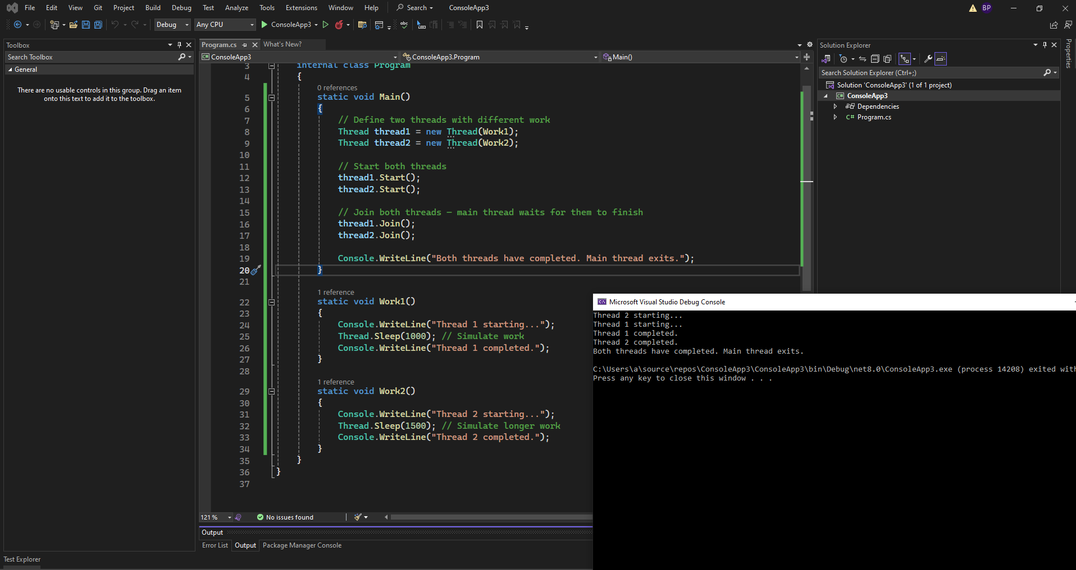

Code and Quiz

Slide 7



What You’ll Need
What You’ll Need
C#
Visual Studio 2022
.NET SDK 8.0

Slide 8

Resources
https://github.com/bhushanpoojary/MultiThreadingDotNet

Slide 9
See You in the Next Module!
"I'm excited to be your guide on this journey. Let’s dive into the world of multithreading and make your .NET apps faster and smarter. See you in the next module!"

